Slide 1
2021.12.05 • ChongQing
Reported by Changjiang Hu

Slide 2
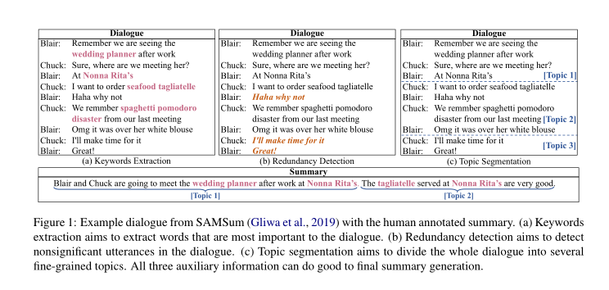
Introduction
A good summary is intuitively related to three aspects
1.Informativeness
2.Redundancy
3.Relevance

Slide 3
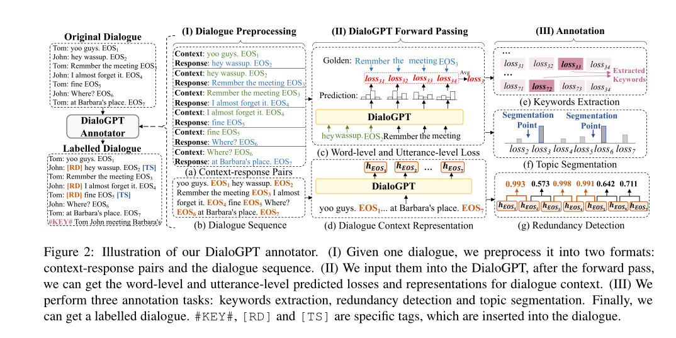
Method

Slide 4
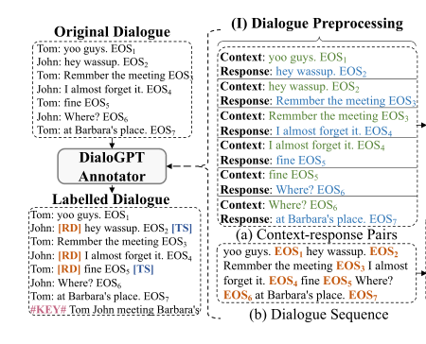
Method
D=
a):
b):

Slide 5
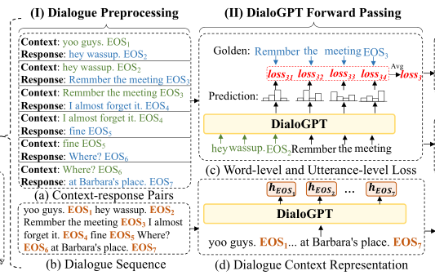
Method

Slide 6
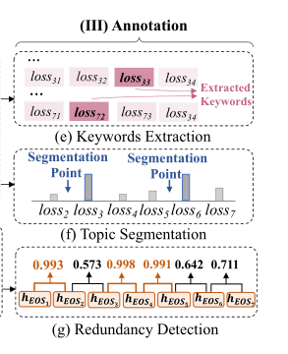
Method
Keywords Extraction
We extract percent of words with the highest loss as keywords, where is a hyper-parameter

Slide 7
Method
Topic Segmentation
We select percent of utterances with the highest loss as topic segmentation points. is a hyper-parameter

Slide 8
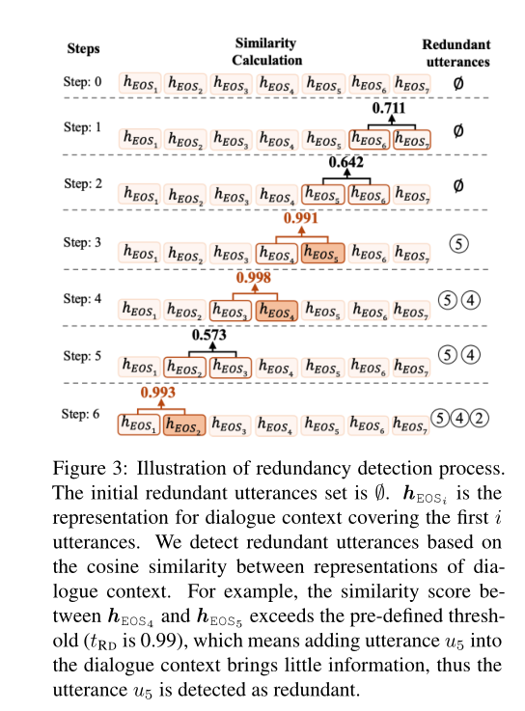
Method
Redundancy Detection

Slide 9
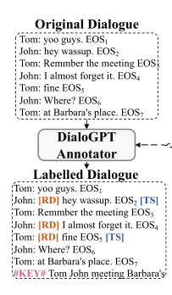
Method

Slide 10
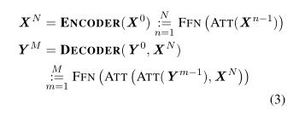
Method
Summarizer
One is BART, which is a Transformer-based model and pre-trained on a huge volume of data
The other is PGN , which is a LSTM-based model

Slide 11
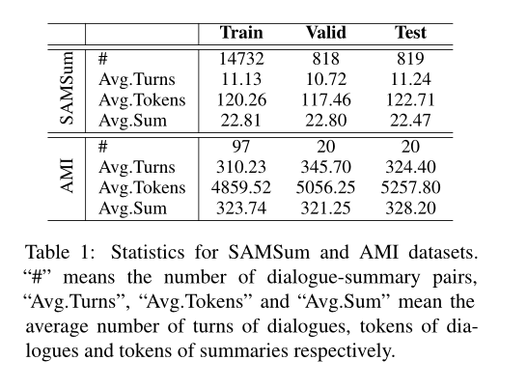
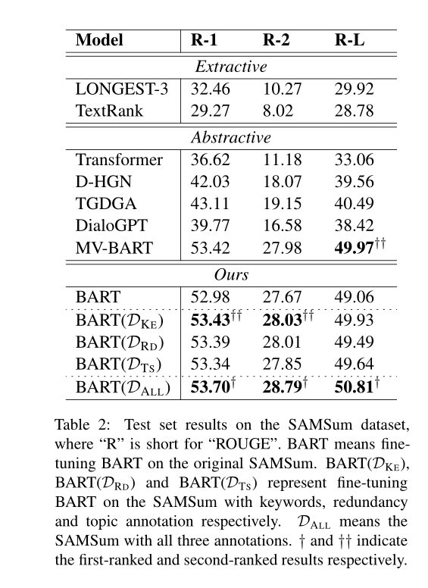
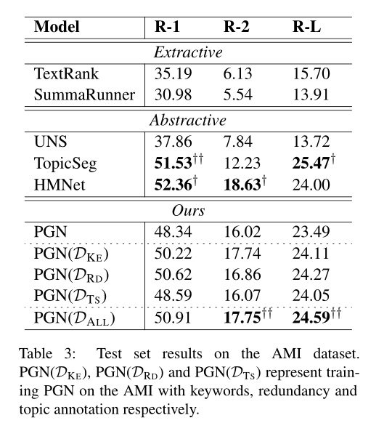
Experiment

Slide 12
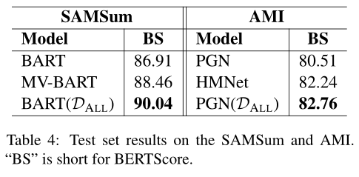
Experiments

Slide 13
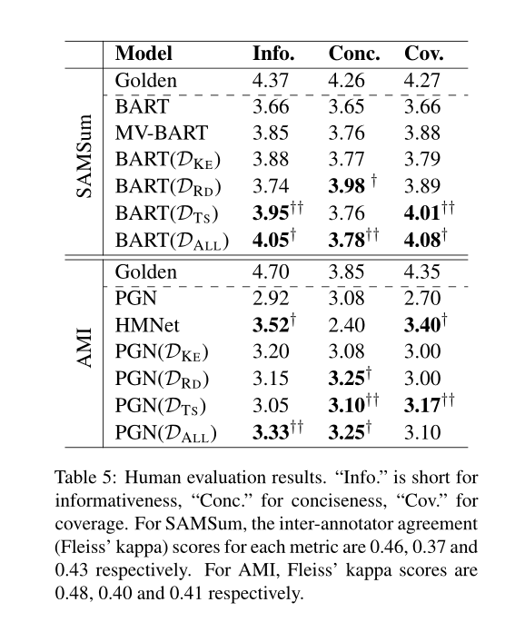
Experiments

Slide 14
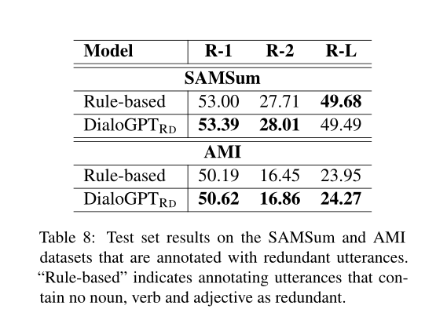
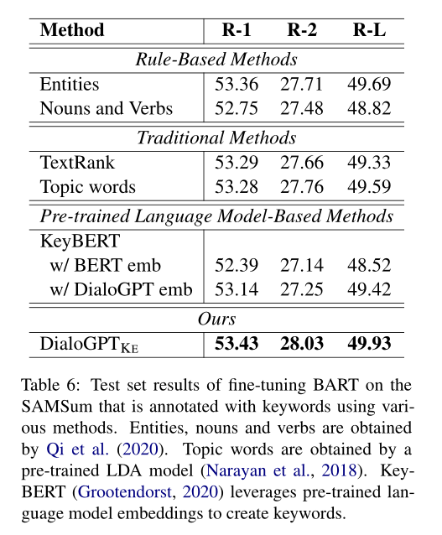
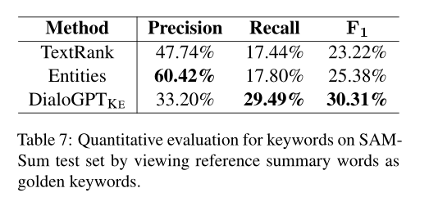
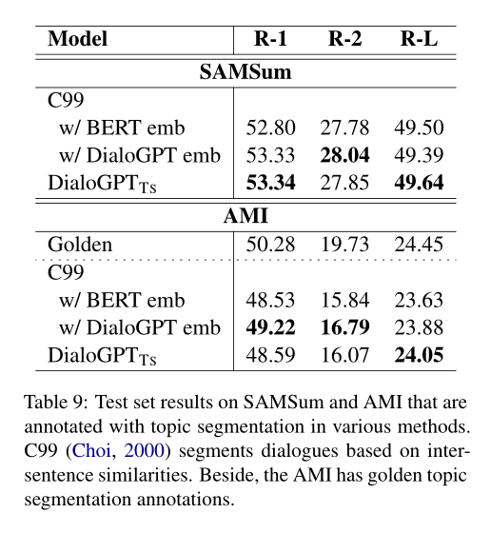
Experiments

Slide 15
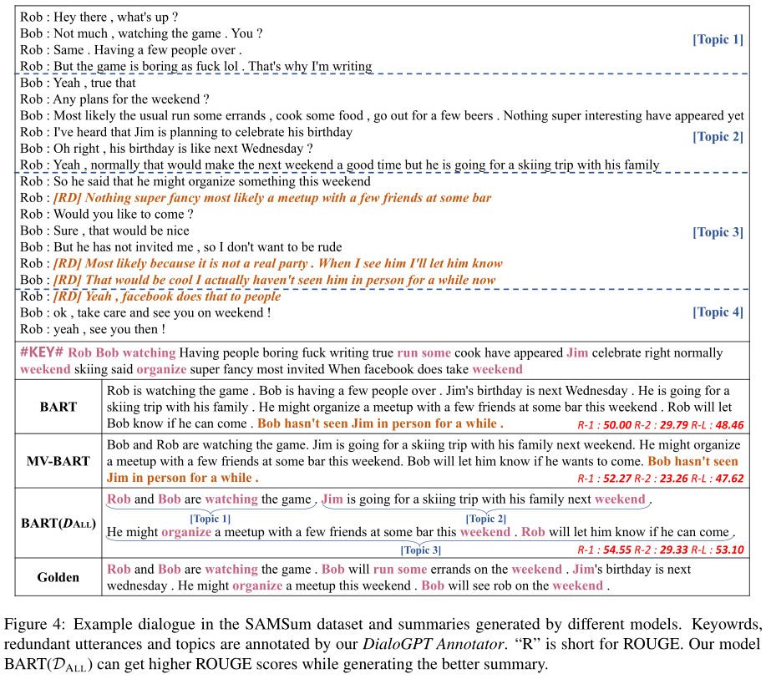
Experiments
Case study

Slide 16
Thanks

